Slide 1

DIRECTORATE OF ONLINE EDUCATION
SRM INSTITUTE OF SCIENCE AND TECHNOLOGY
KATTANKULATHUR- 603 203
MCA III SEM
MINI PROJECT VIVA VOCE
JUNE 2024
EC2332251010432

Slide 2
Azure Peering Concept: Bridging Class A and Class B VNets for Inter-Server Communication
HCL Technologies

Slide 3
TOOLS USED
Azure Virtual Network (VNet)
Azure Resource Manager (ARM)
Azure PowerShell
Network Security Groups (NSGs)
Virtual Machines (VMs)
Microsoft Azure Subscription
Microsoft Entra

Slide 4
INDRODUCTION
In this mini-project, we will provide a demonstration of Azure virtual network (VNet) peering, which is a crucial skill for an internship in a cloud-based environment.
By establishing communication between two servers residing in different VNets with distinct address spaces, we will showcase the power of Azure VNet peering.
Specifically, we will utilize Class A and Class B address spaces for the two VNets, aiming to create a seamless connection between the two networks while preserving their unique subnetting schemes.
This setup will enable secure and efficient data transmission between the two networks, which is a valuable skill for an internship.

Slide 5
PROBLEM DESCRIPTION
In this mini-project, we will demonstrate the implementation of Azure Virtual Network (VNet) peering, a crucial skill for an internship in a cloud-based environment.
The project aims to establish communication between two servers residing in different VNets with distinct address spaces.
By utilizing Class A and Class B address spaces for the two VNets, we will create a seamless connection between the two networks while preserving their unique subnetting schemes. This setup will enable secure and efficient data transmission between the two networks.

Slide 6
MODULE DESCRIPTION
Create two separate VNets In this module, we will create two separate VNets, namely VNet-A and VNet-B, with Class A and Class B address spaces, respectively. This will allow us to have two distinct networks for our demonstration.
Configure peering between VNet-A and VNet-B Here, we will enable the two VNets to communicate with each other as if they are part of the same network. This will be achieved through Azure VNet peering, which will create a seamless connection between the two networks.
Create two virtual machines (VMs) in each VNet In this module, we will set up two VMs in each VNet. This will allow us to demonstrate communication between the two networks.

Slide 7
Demonstrate communication between the two VMs in different VNets
Here, we will showcase the seamless communication between the VMs to highlight the effectiveness of VNet peering.
This will involve sending data between the two VMs and observing the successful transmission.
Assign necessary roles and permissions In this final module, we will ensure secure access and data flow by assigning appropriate roles and permissions.
This will involve setting up user roles and permissions to control access to the VNets and VMs.
By completing this mini-project, we will gain hands-on experience with Azure VNet peering and demonstrate our ability to create a seamless network infrastructure for applications and services.
This skill is highly relevant for an internship in a cloud-based environment, and we will be able to apply this knowledge to real-world scenarios.

Slide 8
Demonstrate communication between the two VMs in different VNets Here, we will showcase the seamless communication between the VMs to highlight the effectiveness of VNet peering. This will involve sending data between the two VMs and observing the successful transmission.
Assign necessary roles and permissions In this final module, we will ensure secure access and data flow by assigning appropriate roles and permissions. This will involve setting up user roles and permissions to control access to the VNets and VMs.
By completing this mini-project, we will gain hands-on experience with Azure VNet peering and demonstrate our ability to create a seamless network infrastructure for applications and services. This skill is highly relevant for an internship in a cloud-based environment, and we will be able to apply this knowledge to real-world scenarios.

Slide 9
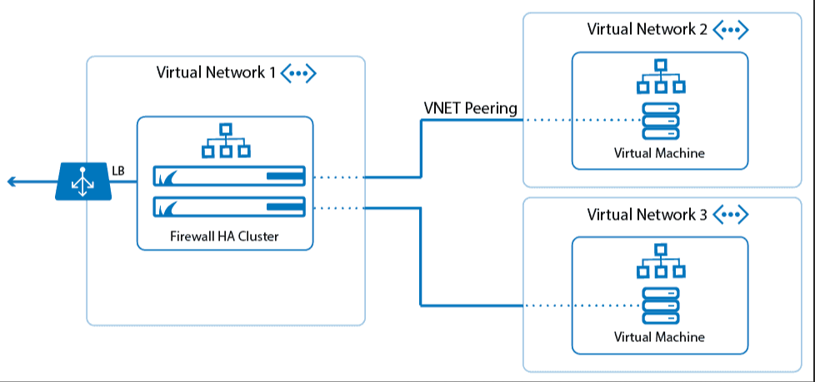
DFA DIAGRAM

Slide 10
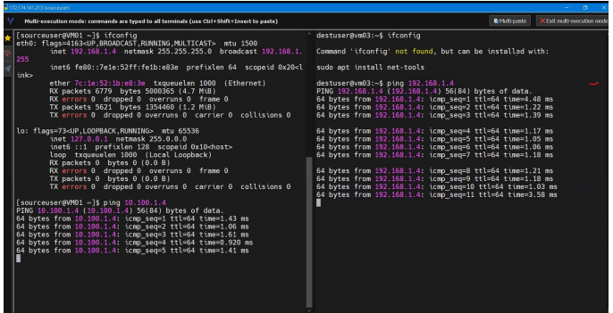
INPUT/OUTPUT SCREENSHOTS

Slide 11
SOURCE CODE
Creating Resource group using PowerShell: $location = 'eastus' $resourceGroupName = 'yResourceGroup' New-AzResourceGroup –Name
$resourceGroupName -Location $location
Creating Virtual Machine using PowerShell:
Step 1: Install the Azure PowerShell module If you haven't already, install the Azure PowerShell module: Install-Module -Name Az

Slide 12
Step 2: Import the Azure PowerShell module Import the Azure PowerShell module: Import-Module -Name Az Step 3: Connect to Azure Connect to Azure using your
credentials: powershell Connect-AzAccount Step
4: Create a resource group Create a resource
group: $resourceGroupName = "myResourceGroupVM" $location = "eastus" New- AzResourceGroup -Name $resourceGroupName -Location $location Step 5: Createe a virtual machine

Slide 13
Create a virtual machine: $vmName = "myVM" $vmConfig = New-AzVMConfig -VMName $vmName -VMSize "Standard_DS2_v2" $vmConfig = Set-AzVMOperatingSystem -VM $vmConfig -Windows -ComputerName $vmName -Credential (Get-Credential) $vmConfig = Add-AzVMNetworkInterface -VM $vmConfig -Name "myNIC" - ResourceGroupName $resourceGroupName -Location $location New-AzVM -ResourceGroupName $resourceGroupName -Location $location -VM $vmConfig. Step 6: Start the virtual machine Start the virtual machine: Start-AzVM -ResourceGroupName $resourceGroupName -Name $vmName Step 7: Get the power state of the virtual machine

Slide 14
Get the power state of the virtual machine: Get-AzVM -ResourceGroupName $resourceGroupName -Name $vmName -Status | Select @{n="Status"; e={$_.Statuses[1].Code}} You can also stop, deallocate, or delete the virtual machine using the following commands: Stop-AzVM -ResourceGroupName $resourceGroupName -Name $vmName -Force Stop-AzVM -ResourceGroupName $resourceGroupName -Name $vmName - StayProvisioned Remove-AzVM -ResourceGroupName $resourceGroupName -Name $vmName Note: Make sure to replace the placeholders (myResourceGroupVM, myVM, eastus) with your actual values. Here are the steps to create a peering connection in Azure using PowerShell: Step 1: Sign in to subscription-1 az login az account set --subscription "subscription-1" Step 2: Sign in to subscription-2 az login

Slide 15
Step 3: Create a role assignment for user-2 vnetid=$(az network vnet show --name vnet-1 --resource-group test-rg --query id --output tsv) az role assignment create --assignee 16d51293-ec4b-43b1-b54b-3422c108321a --role "Network Contributor" --scope $vnetid Step 4: Create a peering connection $netA = @{ Name = 'vnet-1' ResourceGroupName = 'test-rg' } $vnetA = Get-AzVirtualNetwork @netA $peer = @{ Name = 'vnet-1-to-vnet-2' VirtualNetwork = $vnetA RemoteVirtualNetworkId = '/subscriptions//resourceGroups/test-rg2/providers/Microsoft.Network/virtualNetworks/vnet-2' } Add-AzVirtualNetworkPeering @peer Step 5: Verify the peering connection $status = @{ ResourceGroupName = 'test-rg' VirtualNetworkName = 'vnet-1’ } Get-AzVirtualNetworkPeering @status | Format-Table VirtualNetworkName, PeeringState Note: Replace the placeholders (subscription-1, subscription-2, test-rg, vnet-1, vnet-2, 16d51293-ec4b-43b1-b54b-3422c108321a) with your actual values

Slide 16
CONCLUSION
Azure Peering: A Game-Changer for Hybrid and Multi-Cloud Environments Azure peering is a powerful feature that enables seamless communication between Azure virtual networks (VNets) across different subscriptions, regions, and even onpremises environments. By creating a peering connection, you can extend your Azure VNet to other VNets, allowing resources to communicate with each other as if they were part of the same network. Key Benefits of Azure Peering Simplified Network Architecture: Azure peering eliminates the need for complex network architectures, such as VPNs or ExpressRoute connections, to connect VNets. Improved Security: Peering connections are secure and encrypted, ensuring that data transmitted between VNets is protected. Enhanced Collaboration: Azure peering enables teams to collaborate more effectively. by providing a single, unified network environment.

Slide 17
Increased Flexibility: Peering connections can be created and managed dynamically, allowing you to respond quickly to changing business needs. Cost-Effective:Azure peering reduces the need for expensive network infrastructure and minimizes the complexity of managing multiple networks. Use Cases for Azure Peering
Hybrid Cloud: Azure peering enables seamless communication between on-premises environments and Azure VNets.
Multi-Cloud: Peering connections can be used to connect VNets across different cloud providers, such as Azure, AWS, and Google Cloud.
Disaster Recovery: Azure peering enables you to create a disaster recovery site in a different region or subscription. DevOps: Peering connections can be used to create a single, unified network environment for development, testing, and production teams. Best Practices for Azure Peering.

Slide 18
REFERENCES
Microsoft Azure Documentation
Virtual network peering
Createa virtual network peering
Azure Peering Commands
Azure CLI Commands
az network vnet peering create: Create a virtual network peering.
az network vnet peering show: Show the details of a virtual network peering.
az network vnet peering list: List all virtual network peering.
az network route-filter rule add: Add a route filter rule.
Best Practices for Azure Peering Proactive Network Monitoring Scalability Consideration

Slide 19
THANK YOU

